Slide 1
Final Review
Final exam dates:
Class beginning at 8.15 am:
Tuesday, May 10: 10.30 am to 12.30 pm.
Class beginning at 9.20 am:
Wednesday: May 11: 3.30 pm – 5.30 pm.
Class beginning at 1.40 pm:
Monday, May 9: 10.30 am to 12.30 pm.
.

Slide 2
Final Exam
5 questions to choose from a set of 7 questions.
This will be a blue book exam, like the midterm exam.
Chapters: 7 through 12
Please do not forget to do online evaluation of this course. This is extremely important.

Slide 3
Chapter 7: Urbanization and Urban-Rural Migration
1. Define agglomeration and its effects on cities and towns.
Agglomeration = concentration of population, labor, industries and markets in an urban area (city or town)
Effects: Overcrowding, traffic congestions, increased travel time, higher rents, higher cost of living, growth of slums, pollution etc.

Slide 4
2. Mention any two reasons why agglomeration takes place in developing countries.
Reasons: (1) Firms generally want to be in the same place so that they can learn from each other.
Clubs, associations are good for making business contacts. Example: Silicon Valley in California. Software firms in Bangalore (India)
(2) Large population (large working population) living in an urban area makes it easier for companies to find workers, particularly skilled workers.
(3) Large population means large markets, where the goods can be sold with low transport costs.
(4) Sometimes, a city or town grows near the source of raw material– like coal or steel towns
(5) Social Capital : Roads, bridges, financial system (banks, insurance companies). Government often provides social capital where agglomeration is taking place. This leads to growth of formal as well as an informal sector.

Slide 5
3. What is the meaning of ‘first city bias’?
When the cost of doing business in an urban center rises sharply, it may result in the development of a new urban core, near the main city.
This may face chicken-and-egg problem---
Initially, the cost of settling in a new area may be more costly, so everyone waits for the pioneers to start the process.
Eventually, the second city does grow, but it never outgrows the first city--- first city bias.

Slide 6
4. Briefly discuss Paul Krugman’s view that greater openness may control the tendency towards ‘urban giantism’.
Giantism = Concentration of urban population in and around first and second cities.
1. Capital city generally get located in the middle of the country, so that it becomes easier for the ruler to control every part of the country.
2. Rent seeking and capital market failure make the creation of new urban centers practically impossible.
3. Paul Krugman: Import substitution industrialization under the protection of tariff and import control minimizes the size of foreign trade. The entire economic activity rests of the domestic markets.

Slide 7
Firms prefer location where most consumers live or where it is easy to hire workers. This leads to agglomeration.
International trade changes these calculations. When development gets linked to the world markets, there is no particular advantage in urban agglomeration. When the raw materials are imported and goods are sold in the world markets, firms may prefer a location near the border or a sea port or a river port.

Slide 8
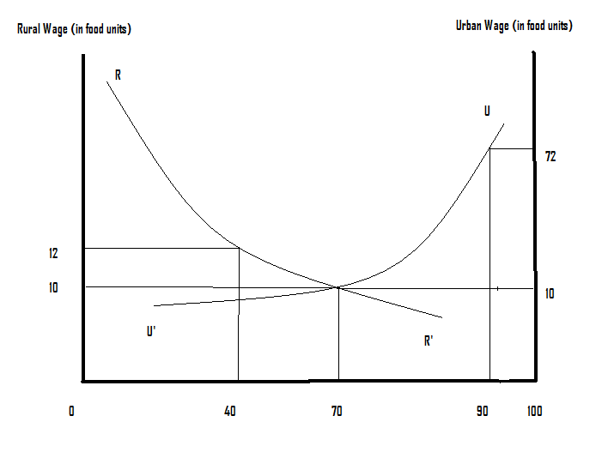

Slide 9
5. The graph drawn above is related to the Harris-Todaro model of rural to urban migration. The curve RR’ is the demand curve for rural labor and the curve UU’ is the demand curve for urban labor. These demand curves show the marginal productivity of labor on the vertical axis. The economy has 100 million urban and rural workers, who are looking for jobs. Assume that the labor markets are perfectly competitive. (i) Then what would be the rural as well as the urban wage rate and how many people would be employed in the rural and urban sectors? Will there be full employment in the economy? (ii) Now assume that the wage rate in the urban sector get pushed up to 72 in food units due to institutional factors. Then how many will get employment in the urban sector? (iii) What would be the probability of getting an urban job? (iv) In the new wage equilibrium, what would be the rural wage rate and the size of rural employment? (v) Will the economy be in full employment? If not, how many workers will be unemployed?

Slide 10
Rural as well as urban wage rate will be 10 in food units and 70 million people will work in the rural sector and 30 million people will work in the urban sector.
10 million.
10/60 = 1/6
Rural wage = (1/6) x 72 =12
Unemployment = 50 million workers.

Slide 11
Chapter 8: Human Capital: Education and Health in Economic Development
1. The roles of education and health in economic development are interrelated. Write about this interrelationship.
Health and education are investments made in the same individual.
Greater health capital may raise investment made in education in several ways:
Health in an important factor in school attendance.
Healthier children are more successful in school and learn more efficiently.
Deaths of school-age children also increase the cost of education per worker.
Longer life spans raise the return to investment in education.
Healthier individuals are better able to use education at any point in life.

Slide 12
Greater educational capital may raise return to investment in health in the following way:
Many health programs rely on skills learned in schools ( including literacy and numeracy)
Schools teach basic personal hygiene and sanitation.
Improvements in productive efficiency from investment in education raise the return on lifesaving investment in health.

Slide 13
2. Discuss any two factors that determine the demand for education.
Wage or income differentials
Probability of success in finding a modern-sector employment
Direct private cost
Indirect or opportunity cost
Non-economic factors: cultural traditions, gender and social status, education of parents, size of family.

Slide 14
3. What is the process of over-certification? Briefly describe it. What are its effects on the distribution of education in developing countries?
Start with substantial wage gaps between primary and secondary school graduates, between secondary school and college graduates and so on.
The rate of increase in modern sector jobs for primary school graduates is less than the rate at which the supply of primary school graduates rises. The same is true for secondary school graduates and college graduates, etc.
Employers face an excess of applicants for all available jobs. They respond by raising the educational qualification requirements for all categories of jobs: high school degree, where only a primary school degree is enough for job performance, college degree, where only a high school degree is enough, etc.---- Over-certification

Slide 15
Governments, under the political pressure from the educated, bind wage rate to the educational attainment of the job seekers, rather than to the minimum educational qualification required for the job.
5. School fees at the early primary level of education are nominal or close to zero, rises at late primary and secondary level and then decline at the college and higher educational levels.
These conditions prevail in most developing countries. Examples: Mexico, Egypt, India, Pakistan, Ghana, Nigeria and Kenya.
Implications: Expected private return from education far exceeds the private cost. The gap rises with the level of education. This causes extreme inequality in the distribution of education.

Slide 16
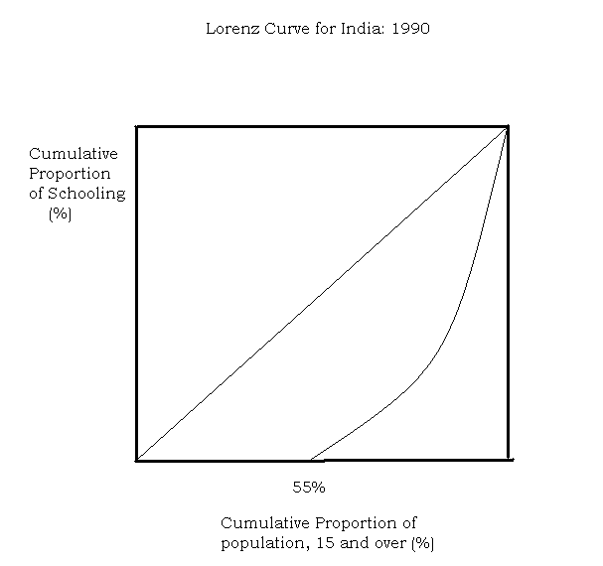

Slide 17
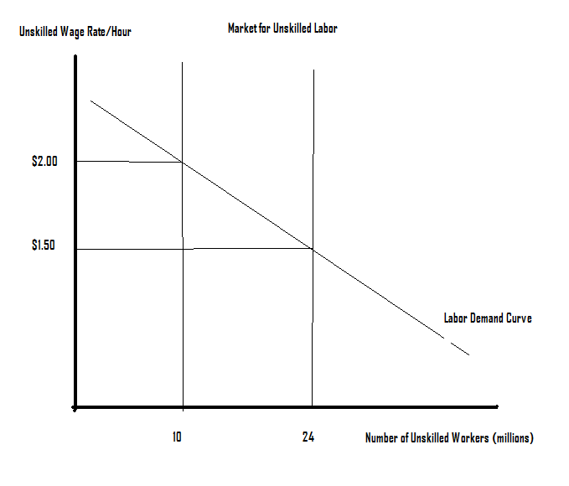

Slide 18
4. The diagram drawn above shows the market for unskilled labor in which child workers may get hired, depending upon the circumstances. Currently, there are 10 million adult workers who are available for employment at the equilibrium wage rate of $2.00 per hour and no child worker is in the labor force in this market. (i) If the employers offer a wage rate of $1.50 and no child worker is allowed to work, how large will be the shortage of unskilled labor? (ii) Assume that it is legal to employ a child worker and that the productivity of a child worker is ½ of the productivity of an adult worker. Then, how many child workers would be working at this lower wage rate of $1.50? How much would a child worker earn per hour?

Slide 19
Shortage = 24 – 10 = 14 adult workers
14 x 2 = 28 child workers
A child worker will earn ½ x $1.50 = $0.75 per hour.
5. What are the alternatives to a complete ban on child labor?

Slide 20
Child labor is an expression of poverty. Deal with poverty first--- The World Bank
Get more children to school--- night schools, cash incentives for parents to send children to school. Probably better than the idea of compulsory education. Some international agencies support this strategy.
Child labor is inevitable, at least in the short run. Provide support system (prevent child abuse, illegal child trafficking, prevent economic exploitation of the child)-----UNICEF
ILO : Favors child labor ban, at least in its most abusive form.

Slide 21
6. What are the health challenges faced by the developing nations?
Absolute poverty: classified as a disease according to international classification of diseases: code Z59.5---extreme poverty.
Malnutrition: It is the root of many diseases. 800 million people suffer from malnutrition and 2 billion people suffer from micronutrient deficiency.
3. AIDS: Acquired immunodeficiency syndrome (also HIV: Human immunodeficiency virus)
It is now the leading cause of death among working age population in the developing world. Hardest-hit region: Sub-Saharan Africa.
4. Malaria: Once in retreat, now a deadly strain has come back, particularly in Africa. Kills over one million each year, 70% of them being under-5.

Slide 22
5. Tuberculosis: Claims about 2 million lives each year.
6. Acute lower respiratory infections: primarily pneumonia, accounts for 20% of deaths among children under age 5.
7. Hepatitis-B: Predicted to kill about one million people.
8. Cholera: A come-back story like malaria
Other important diseases: Dengue, Leprosy, etc.

Slide 23
Chapter 9 : Agricultural Transformation and Rural Development
1. Explain the following terms: subsistence farming, shifting cultivation, Latifundios and minifundios.
Subsistence Farming: Farming in which crop production and other activities are conducted mainly for personal consumption. The traditional farming techniques leads to low land productivity.
Shifting Cultivation: Tilling land until it has been exhausted of fertility and then moving to a new parcel of land, leaving the former land to regain fertility until it can be cultivated again.

Slide 24
Latifundios: Very large land holding capable of employing at least 12 workers and up to 1000 workers. The owners are often more concerned with power and prestige, rather than land productivity. High transaction cost (cost of supervising labor in such large land areas)
Minifundios: The smallest farms, not even large enough to provide employment for a single family.

Slide 25
1. How would you define ‘land Gini’? Explain why land Gini is so much higher in Latin America, compared to Asia.

Slide 26
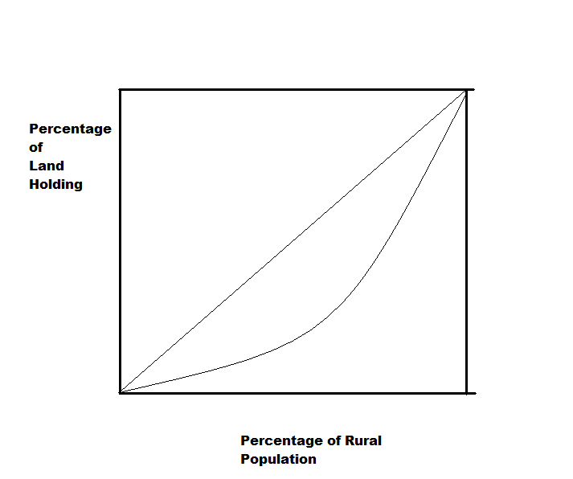

Slide 27
Land Gini coefficient is measured by ½ the area enclosed by the diagonal and the lorenz curve.

Slide 28
Land Distribution: Asia and Latin America
 | Average Farm Size (hectares) | Gini coefficient
Bangladesh | 1.6 | 0.42
India | 2.3 | 0.62
Indonesia | 1.1 | 0.56
Nepal | 1.0 | 0.56
Philippines | 3.6 | 0.51
Thailand | 3.7 | 0.45
Brazil | 59.7 | 0.84
Costa Rica | 38.1 | 0.82
Colombia | 26.3 | 0.86
Peru | 16.9 | 0.91
Uruguay | 214.1 | 0.82
Venezuela | 91.1 | 0.91

Slide 29
A large part of Latin America has the system of Latifundios, resulting in large landholding among a few rich farmers. In Asia, subdivision and fragmentation of land has been the result of rapid population growth and land acquisition by village money lenders. The colonial system of large landlords, who collected taxes on behalf of the colonial rulers, was abandoned in the post colonial period.

Slide 30
3. Currently agriculture performs a supporting role for the rest of the economy in developing countries. Mention any two of these supporting roles.

Slide 31
Product contribution: To provide inputs for the industry, like raw cotton for textiles, food for food processing.
Foreign exchange contribution: agricultural export revenues used to import capital goods for the industry.
Product market contribution: rising rural incomes generate additional demand for manufactured goods.
Factor market contribution: Surplus labor moves out of agriculture and gets absorbed in industrial occupation. When surplus labor is exhausted, some part of agriculture may be run on profit motive and farm profit may get invested in industry (Lewis Model).
The effect of all this process is a decline in the relative importance of agriculture.----considered as an indicator of development.
Current view: agriculture should a more active role, rather than a supportive or passive role. Without an integrated rural development, industrial growth causes severe imbalances in the economy and the society.

Slide 32
4. Distinguish between a tenant farmer and a sharecropper. Whose exposure to risk is greater and why?
Fixed Rent Tenancy: The farmer does not own land, gets a piece of land from a big landowner and pays a fixed rent. The farmer is exposed to risk, the big landowner has no risk.
A sharecropper does not own land, gets a piece of land from a big landowner in exchange for a share of crop produced that must be given to the big landowner. The share is contractually determined. This results in risk-sharing.

Slide 33
5. Briefly discuss any two major sources of risk in agricultural occupation.
Price uncertainty: The farmers face a price band rather than a single market price for the product. This makes subsistence agriculture extremely risky. If the family is close to poverty line, low prices may cause starvation.
In addition to the price uncertainty, there is weather uncertainty and technological uncertainty

Slide 34
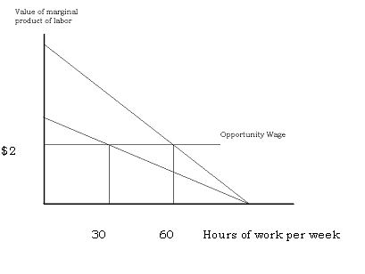

Slide 35
7. A tenant farmer (paying the landlord a fixed rent) or a sharecropper can make $2 per hour in non-farm rural jobs. The graph, drawn above, shows the market value of the marginal product of labor, if they decide to work on the farmland. How many hours will each put in per week?

Slide 36
The tenant farmer will work 60 hours per week and the sharecropper will work 30 hours per week.
8. Sharecropping is an inefficient agrarian system. Do you agree with this view? Discuss.
In view of the previous question, sharecropping seems apparently inefficient. But competition among sharecroppers may reduce inefficiency. Also, sharecropping results in risk-sharing and this may make the sharecropping outcome socially efficient.

Slide 37
9. Would you advocate large scale farming as a solution of low agricultural productivity in developing countries?
New agricultural technology and innovations can improve productivity and raise output. Large scale farming, using labor saving machinery can dramatically increase yield.
Problems: Large scale farming would cause unemployment of farm workers and raise poverty.
Biological innovations (hybrid seeds and biotechnology), water control (irrigation) and chemical innovations (fertilizer, pesticides and insecticides) are scale-neutral. These work equally well in small and large farms. Risk averse farmers may resist these innovations. Scope for government’s role.

Slide 38
10. Write a brief note on integrated rural development.
IRD involves the following:
Efforts to raise both farm and non-farm rural incomes (in real terms) through job creation, rural industrialization and other non-farm opportunities and the increased provision of education, health, nutrition and housing, and a variety of social and welfare services.
A decreasing inequality in the distribution of rural incomes and a lessening of urban-rural imbalances in incomes and economic opportunities.
Successful attention to the need for environmental sustainability --- limiting the extension of farmland into remaining forest, promoting conservation and preventing harmful use of agrochemicals and other inputs.
The capacity of the rural sector to sustain and accelerate the pace of these improvements over time.

Slide 39
Chapter 10: The Environment and Development
1. Briefly explain the following terms: Sustainable Development, Global Warming, Climate Change, Green Accounting, Environmental Capital and Environmental Kuznets Curve.

Slide 40
Global Warming: Increasing average air and ocean temperature, attributed largely to human industrial, forestry and agricultural activities emitting greenhouse gases.
Climate Change: Non-transient altering of underlying climate---- increased average temperature, decreased annual precipitation and greater average intensity of droughts and storms.

Slide 41
Sustainable Development: A pattern of development that permits future generation to live at least as well as the current generation, involving at least a minimum environmental protection.
Environmental Accounting: The incorporation of environmental costs and benefits in to the quantitative analysis of economic activities.
Environmental Capital: The portion of a country’s overall capital assets directly relates to the environment-------forest, soil quality and ground water.
Sustainable net national income (NNI*): An environmental accounting measure of the total annual income that can be consumed without diminishing the overall capital assets including environmental capital.

Slide 42
NNI* = GNI – Dm – Dn
GNI = Gross National Income
Dm = Depreciation of manufactured capital assets
Dn = Depreciation of environmental capital
NNI** = NNI* - R – A
R = Expenditure required to restore environmental capital (forests, fisheries, etc.)
A= Expenditure required to avert destruction of environmental capital ( air pollution, water and soil quality)

Slide 43
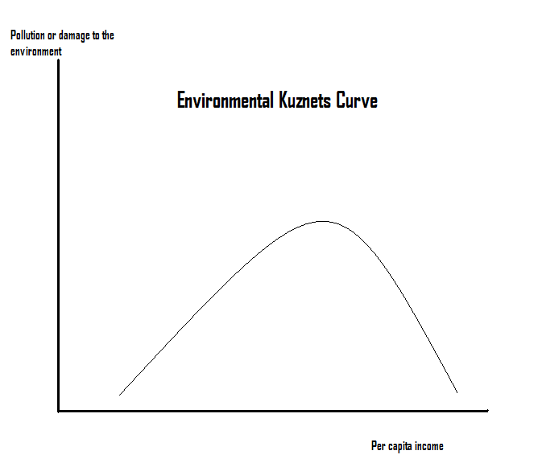

Slide 44
2. What are the four conditions of private property markets?
Universality: all resources are privately owned.
Exclusivity or excludability: it must be possible to prevent others from benefiting form a privately owned resource.
Transferability: The owner of a resource may sell the resource when desired.
Enforceability: The intended market distribution of the benefits from resources must be enforceable.

Slide 45
3. How does private ownership of a resource protect its environmental quality?
Under private property ownership, the owner of a resource has the economic incentive to maximize the net benefit from its sale or use.
The owner of land will choose the level of investment, technology and output that maximize the net yield from the land. The owner will also have the incentive to maintain the environmental quality of land and to avoid future degradation and loss of future incomes.

Slide 46
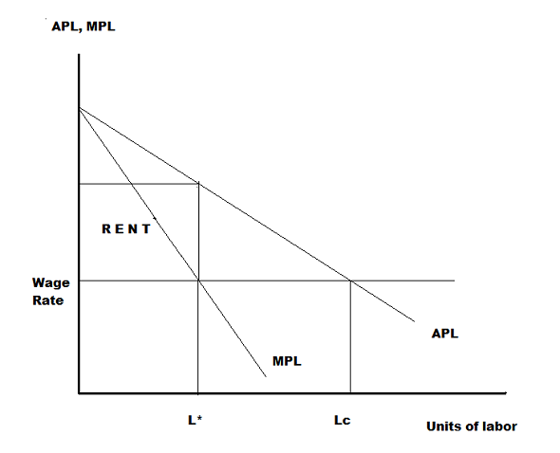

Slide 47
4. The graph, drawn above, shows the average product of labor and the marginal product of labor applied on a fixed resource, like land. Explain why the resource is overused (Lc labor units are applied on the resource), if it is a common property but it is properly used (L* labor units are applied on the resource), if it is privately owned.

Slide 48
Private ownership of a scarce resource (such as land): The owner will employ labor till the wage rate is equal to the marginal product of labor. The level of employment will be L*. The owner will get rent = Total production minus total output going to L* number of workers.
If the land is a common property, each worker will be able to appropriate the average product of labor and employment will be at the level=Lc, where wage rate (in this case, the opportunity cost of working on the common land) = APL. From L* to Lc: Total production may actually decrease, if MPL at Lc is negative.

Slide 49
5. Elinor Ostrom has laid down certain conditions for a fair and efficient management of a common property. Mention any two of these conditions.
Clearly define boundaries: Define clearly the boundaries of a resource (irrigation or fishery) assigned to individuals or households.
Proportional equivalence between benefits and costs: The right of an individual or a household to use common resource should be proportionately linked to cost he/she is willing to bear (labor, material or money input).
Collective Choice: The individuals included in this program of common property should have the right to modify rules through collective choice.
Monitoring: Monitors should assess biophysical conditions. They are accountable to the users.
Graduated Sanctions: Violators of rules should receive graduated sanctions (severity of penalty depending on the seriousness of offence) from other users or from officials.

Slide 50
6. Conflict Resolution Mechanism: Availability of local, rapid and low-cost mechanism of conflict resolution.
7. At least minimal recognition of rights to organize: Users have a long term tenure right to the resource and they should have the right to devise their own system.
8. Nested Enterprises: Appropriation, provision, monitoring, enforcement, conflict resolution and governance activities are to be organized in multiple layers of nested enterprises.

Slide 51
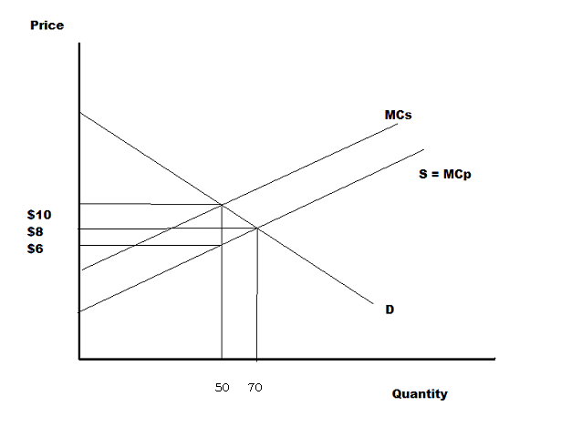

Slide 52
6. The graph shows the demand curve for a product (D), marginal private cost (MCp) curve and the marginal social cost curve (MCs). The vertical gap between MCs and MCp is the society’s evaluation of marginal damage caused by productive activity to the environment and this gap is fixed at $4 per unit of output produced. (i) Without the intervention of the government, how many units are going to be produced and what is going to be the market price? (ii) What should be the rate of a pollution tax? (iii) How many units are going to be produced, if there is a pollution tax and what is going to be price of the product? (iv) How is the burden of the pollution tax going to be shared between the consumers and the producers?

Slide 53
70 units will be produced and sold at $8 per unit
Pollution tax = $4 per unit produced.
50 units will be produced and sold at $10 per unit.
Consumers will be $2 and the producers will pay $2 of the pollution tax.

Slide 54
7. Mention any two policy options for the developing countries for dealing with the environmental problems.
Proper Resource Pricing: Energy, water and agricultural subsidies meant for the poor households are often captured by wealthy household. Subsidized pricing of environmental resources for the wealthy users should stop. Implementation may be difficult.
Community Involvement: Involvement of local communities in environmental projects. Role of NGO (non-governmental organizations in promoting environmental awareness. ‘Chipko’ movement in India.
Property Rights and Resource Ownership: Creation of property rights for sharecroppers and landless workers who rent land from landlords (land reform) so that they have incentives to maintain the environmental quality of land

Slide 55
4. Provision of Economic Alternatives for the Poor: Government should provide credit to low income farming families to purchase land-augmenting inputs that improve the fertility of land. This would prevent environmental degradation of soil.
Creation of alternative employment opportunities in the rural economy: Programs to build infrastructure (roads, storage facilities, marketing cooperatives) would alleviate population pressure on ecologically sensitive land and reduce rural-urban migration.
5. Raising the economic status of women: In their day-to-day operations, women determine the pattern of resource use. Environmental education of women would promote sustainable management of water and fuel supply.

Slide 56
6. Industrial Emission Abatement Policy: Policies to limit industrial pollution are: emission tax, tradable permits, quotas and standards. The first two policies are market based and are found to be more effective than the quotas and standards, which are known as command-and- control policies. In many developing countries, government is a producer and often the government producer does not self-regulate due to the lack of profit motive.
7. Protection against Climate Change and Environmental Degradation: Early warning system, reforestation, storm shelters, flood barriers, protected roads and bridges.

Slide 57
8. Briefly discuss how developed countries may help LDCs in their environmental programs.
Trade Policies: Reduction of trade barriers against imports from LDCs. This has the long term effect of raising incomes and reduction of poverty to limit environmental damage.
Debt Servicing: Debt servicing or debt forgiveness would release funds for the protection of the environment.
Debt-for-Nature Swaps: Private environmental organizations (U.S. based Rainforest Alliance or Nature Conservancy) buy LDC’s foreign debt at at a discount (like 30% of the face value) and exchanges this debt for the local government bonds worth the full value of the original debt.
($100 million debt bought at $30 million. Now foreign government owes Rainforest Alliance $100 million. RA now converts this asset into local government bonds worth $100 million. This means that with an investment of $30 million, RA now owns local government bonds worth $100 million. Earnings from these bonds are used to maintain forests and wildlife.)

Slide 58
Development Assistance to implement environmental programs like reduction of CO2 emissions.

Slide 59
Chapter 11
Define a mixed economy. Mention the objectives of the public sector in a mixed economy.
A economy which has two broadly defined sectors: A public sectors (owned by the government and run by bureaucracy to produce goods and services, not always for the profit) and a private sector (privately owned and run for profit). The private sector runs efficiently provided the markets are developed and competitive. In many instances, the government intervenes the operation of the private sector.

Slide 60
Objectives of the Public Sector
To provide public goods or an economic infrastructure: railways, schools, hydroelectric projects etc.
To implement economic policies: taxation, industrial licensing, setting of tariffs, quotas, wages, interest rates and prices. The objective is to stimulate, direct and sometimes control the private sector for social and political reasons.

Slide 61
2. What are the two gaps in the two-gap model? Is there a third gap? If yes, then what is it?
Most developing countries face two gaps: (1) a shortage of domestic savings to match investment opportunities and (2) a shortage of foreign exchange to finance the needed imports of capital goods and intermediate goods. The two gaps are savings gap and foreign exchange gap. Each may turn out to be a bottleneck in the process of economic growth.
A possible third gap: Even if the two gaps are met, the private sector investment will not happen without a complementary provision of public goods ( infrastructure).

Slide 62
3. Mention any two elements of “Washington Consensus”. What was the problem in some LDCs that followed Washington Consensus?
Fiscal Discipline
Redirection of public expenditure priorities toward health, education and infrastructure.
Tax reform: broadening the tax base and reducing the marginal tax rate.
Unified and competitive exchange rates
5. Secure Property Rights
6. Deregulation
7. Trade Liberalization
8. Privatization
9. Elimination of barriers to direct foreign investment
10. Financial Liberalization

Slide 63
4. What is an NGO? What kind of goods and services do the NGOs provide? Mention any two advantages of NGOs over government or the market in the process of economic development.
NGOs are non-profit, voluntary citizens’ groups, organized on a local, national or even international level. They are task-oriented and driven by people with a common interest.

Slide 64
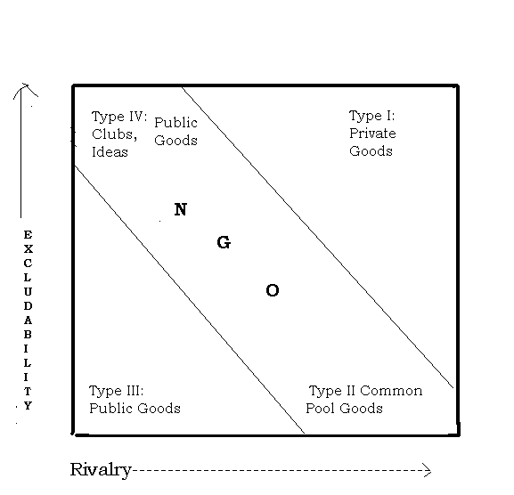

Slide 65
NGO: Areas of comparative advantage
Innovation: Private sector is not concerned with poverty; Government tends to design uniform programs that may not address special needs of the poor. NGOs, with the knowledge of local needs and constraints, have to scope to innovate.
NGO innovations in non-formal education: community literacy programs, educational village theater, use of computer technology in urban slums, subtitled music videos for education 65

Slide 66
2. Program Flexibility
Flexibility = localized innovations or minor adaptations of the program innovations to suit local needs. NGOs tailor their programs to fit available funding.
Example: BRAC ( Bangladesh Rural Advancement Committee), founded in the early 1970s, to aid displaced persons in the aftermath of civil war and famine.Now the largest NGO in the world, accounting for 1% of Bangladesh’s GDP. Runs micro-credit program. When a catastrophic flood hit Bangladesh in 2004, BRAC temporarily reassigned its entire activity to flood relief. 66

Slide 67
3. Specialized Technical Knowledge
Some national, but mostly international NGOs have specialized technical knowledge, which the local government may not have.
This technical knowledge results in innovations. Example: Grameen Phone Lady Model—A part of micro-credit program– credit and training are provided to village women to purchase and operate cell phone service to community members on a fee basis. 67

Slide 68
4. Targeted Local Public Goods
Goods and services that are rival and excludable. Target groups that would be normally excluded can be included.
Examples: local public health programs, non-formal education, creation of local markets, community mapping, property registration, community negotiations with the government 68

Slide 69
5. Common-Property Resource Management and Implementation
Private sector and governments have a poor track record in ensuring sustainability of forests, lakes, coastal fishing areas, pastureland,and other commons. These resources are rival but non-excludable. NGOs can provide leadership in the management and implementation of cooperative programs of sustainability. 69

Slide 70
6. Trust and Credibility
Evan a democratically elected government may marginalize the extreme poor to the benefit of the majority that is less poor. NGOs, with their dedication and personal contacts may win trust and implement more credible programs, rather than government bureaucrats who are often corrupt.
70

Slide 71
7. Representation and Advocacy
NGOs represent minority groups in a democratic system where the rule of the majority prevails. Thus, the NGOs act as advocacy groups and lobby in behalf of the minority groups that have special needs. Sometimes, the international NGOs performs functions, meant for the government or the private sector.
Example: International NGO Africare has built roads and later transferred the roads to the government
Advocacy is non-rival and non-excludable. 71

Slide 72
Chapter 12
1. A precise definition of globalization is difficult, but globalization is a process. Describe this process.
Globalization: A process by which the economies of the world become increasingly integrated, creating a global economy.
Policy making in the global economy becomes centralized in the hands of a few international organizations like WTO
A global culture is created. People develop the tendency to consume similar goods and services, speak a common language of business (i.e. English)

Slide 73
Globalization has impact on every country, but its maximum impact is on the developing world.
Globalization may raise international income disparities. It may worsen income distribution in a country.
Globalization may cause environmental problems in the developing countries (Pollution Havens) and cause global warming and weather change

Slide 74
2. Write a short history of globalization taking the period: 1900-1929.
1900 - Great Depression of 1929.
This is the period when most of today’s advanced economies were globalized through expansion of trade in goods and services and movement of labor and capital.
During this time, most LDCs were outside the global markets, following autarkic policies.
Self-sufficiency was the goal for most of them.
Many of them were colonies. After getting independence, a large number of LDCs decided to remain non-aligned in the bipolar world that emerged after the second world war.
Many believed that the world economy had nothing for them.

Slide 75
3. Discuss how the Great Depression halted the process of globalization.
The process of globalization was halted in the developed world.
Each country worried about its own unemployment problem and ignored the global economy.
Mercantilism returned: Each country tries to increase export (foreign sale of goods produced in the country) and reduce import (buying goods from foreign countries).
Reason: exports would raise employment and imports would reduce employment.

Slide 76
Mercantilist policies:
(i)Put high taxes (customs tariffs) on imported goods and allow government subsidy to the exporting industries.
(ii) Devaluation of currency: making currency cheaper for the foreigners. Foreigners would find US goods cheaper because dollar is cheaper. US consumers would find foreign goods more expensive because foreign currencies are more expensive.

Slide 77
4. Briefly discuss three major agreements at the Bretton Woods Conference.
A conference was held in Bretton Woods,
July 1-22, 1944
730 delegates from 44 allied nations participated.
Major decisions:
International bank for reconstruction and development (IBRD), now called the World Bank.

Slide 78
International Monetary Fund (IMF)
General Agreement on Tariffs and Trade (GATT)
IBRD: Originally set up to transfer funds from USA to Western Europe under the Marshall Plan to finance reconstruction of war-devastated Europe. Currently, the World Bank provides development assistance to the less developed countries.

Slide 79
IMF: It stopped competitive devaluation among nations. Introduced a system of fixed exchange rates. Values of major currencies like British pound, French Franc, German Mark etc are to be fixed in terms of US dollar. The value of US dollar will be fixed in terms of gold. This is called the gold exchange standard or the dollar standard.
The governments are obligated to keep their currency values fixed. US is obligated to keep its currency value in gold fixed.

Slide 80
What happens if a country is unable to keep its currency value fixed because it has a deficit in the balance of payment? This means that this country could not earn enough dollars and other foreign currencies to pay for its imports. There are two ways:
(i) The country could take a loan in foreign currency from IMF.
(ii) If its balance of payment deficit is very serious, IMF would allow the country to devalue its currency.

Slide 81
The original proposal in the Bretton Woods conference was to set up an international trade organization(ITO). But the Congress in USA did not ratify the ITO treaty. A compromise was reached: GATT.
Objectives of GATT
1. To reverse the tariff war and set up several ‘rounds’ of trade negotiations to reduce tariff rates on a reciprocal basis and do away with quotas as soon as possible. Important rounds: Kennedy round, Tokyo round, Uruguay round, Doha round.
2. To formulate rules for foreign investment. Example: foreign investors are eligible for national treatment.
3. To provide temporary exceptions to less developed countries.---Preferential trading between DCs and LDCs.
4. To settle trade disputes.
Uruguay Round (1986-1994): Agreement was reached to set up the World Trade Organization. WTO started functioning from January 1995.

Slide 82
5. Write a note on the Prebisch-Singer Thesis.
The terms of trade of countries that export primary goods = Average price of primary goods / Average price of manufactures.
Prebisch & Singer: There has been a long term declining trend in the in the terms of trade of the primary good exporting countries, excluding the oil producing countries.
They also observed that the prices of primary goods are more unstable than the prices of manufactures, causing export earnings instability in these countries.

Slide 83
6. What is the policy of import substitution? Has this policy worked for the developing countries? If not, what are the problems of this policy?
The policy of reducing the import of foreign goods and producing these goods in the home country. This policy has rarely worked.
Many IS industries remain inefficient and costly to operate.
Foreign firms jump the tariff wall and benefit from the local IS policy.
IS policy is often combined with import of capital goods that are subsidized by the local government. Foreign firms and their local partners grab the benefits. The LDC develops balance of payment problems. The capital intensive industries that are the beneficiaries of IS policies cater to the consumption habits of the rich. Since these industries are capital intensive, the growth of employment is the least.

Slide 84
4. Another element of IS strategy: overvalued exchange rate to make capital good import cheaper. Example: Free market exchange rate is 20 Mexican Peso = $1. The government fixes this rate at 10 Peso = $1. This hurts the export industries of Mexico.
5. Infant industries never grow. IS creates special interest groups that perpetuate inefficiency and backwardness.

Slide 85
7. Mention any two benefits of export promotion policy.
Encouraging manufactured exports serves the purpose of export diversification in primary good exporting nations.
In overpopulated countries, exports are labor intensive products. Expansion of these industries would generate more employment than import substitution industries would.
By definition, export industries are more efficient than import substitution industries. Thus export promotions results in a better allocation of resources.

Slide 86
4. Economy of scale argument: The size of the export industry is small, because the size of the local market is small. If the industry is subsidized, so that it can operate on a bigger scale in the world market, it can reduce its costs due to economy of scale.

